Slide 1
Housing price model

Slide 2
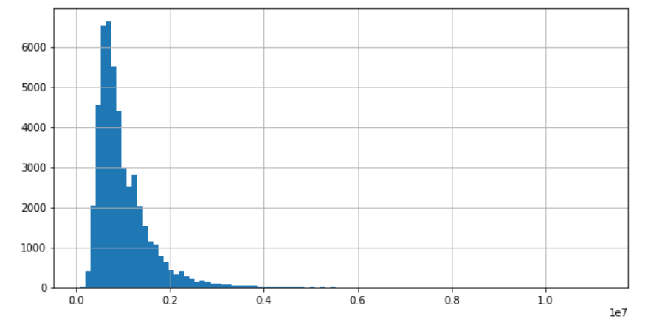
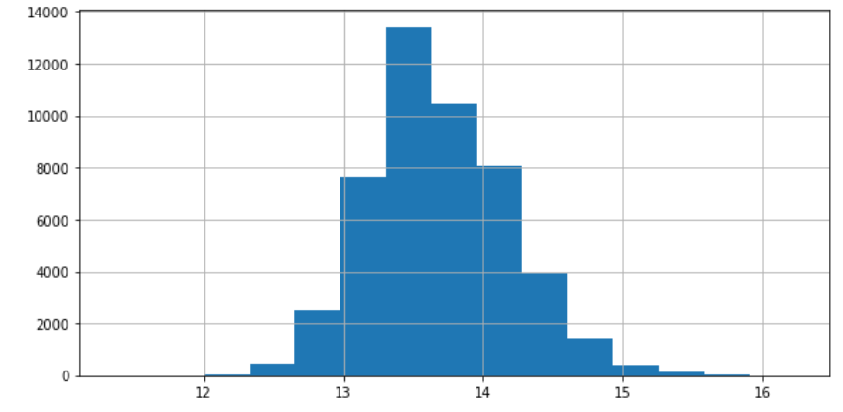
Skewed distribution of Price
Price
Log (Price)

Slide 3
Columns in the data set
Suburb object
Address object
Rooms int64 - # rooms in the property
Type object - Type of the property
Price float64 - Price
Method object - Method of sale
SellerG object
Date object - Date Sold
Postcode int64
Regionname object - name of region e.g. Western Metropolitan
Propertycount int64 - # of property in the suburb
Distance float64 - distance from CBD in
CouncilArea object

Slide 4
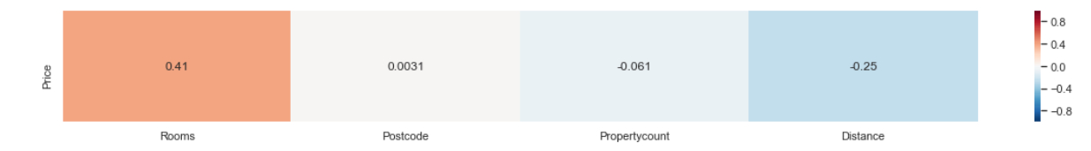
Correlation of numerical features
Rooms and Distance were fairly well correlated with Price

Slide 5
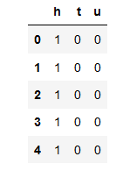
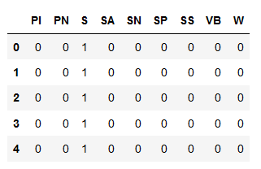
Dummy variables
Type – type of property
Method – method of sale
S - property sold
SP - property sold prior
PI - property passed in
PN - sold prior not disclosed
SN - sold not disclosed
VB - vendor bid
W - withdrawn prior to auction
SA - sold after auction
h – House
t – Townhouse
u – Unit

Slide 6
The models used in the analysis
LinearRegression()
RidgeCV – optimised hyper-parameteres with cross validation
LassoCV – optimised hyper-parameteres with cross validation
ElasticNet() – a combination of Lasso and Ridge
Polynomial features
Logistic regression
KNN

Slide 7
Price
w/ log(Price)
Null: RMSE: 587,819
features
Rooms
Distance
Dummy Type
Year
features
Rooms
Distance
Dummy Type
Year
lin reg: RMSE: 474,144
Ridge: RMSE: 474,150
Lasso: RMSE: 474,143
enet: RMSE: 474,143
lin reg: RMSE: 0.3719 Exp RMSE: 472,852
Ridge: RMSE: 0.3719 Exp RMSE: 472,980
Lasso: RMSE: 0.3719 Exp RMSE: 472,953
enet: RMSE: 0.3719 Exp RMSE: 472,985
features
Rooms
Propertycount
Distance
Dummy Type
Dummy Method
Year
features
Rooms
Propertycount
Distance
Dummy Type
Dummy Method
Year
linreg: RMSE: 0.3695 Exp RMSE: 470,482
Ridge: RMSE: 0.3696 Exp RMSE: 470,618
Lasso: RMSE: 0.36962 Exp RMSE: 470,635
enet: RMSE: 0.3696 Exp RMSE: 470,643
lin reg: RMSE: 472,429
Ridge: RMSE: 472,517
Lasso: RMSE: 472,501
enet: RMSE: 472,501

Slide 8
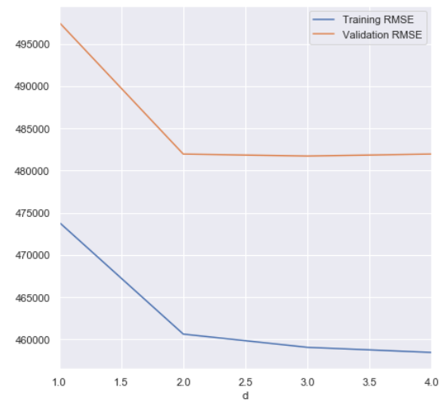
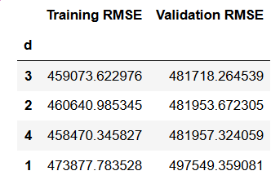
Polynomial features
The optimal hyper-parameter for the polynomial degree = 2
However the validation RMSE is still relatively high

Slide 9
Classification
Since in the data set there were quite a lot of rows that were cut due to missing values, classification model may be useful to use as a “filler” for increasing the available data set
Null Accuracy: 0.701
The most frequent class : House
Features used
['Rooms','Propertycount','Distance']

Slide 10
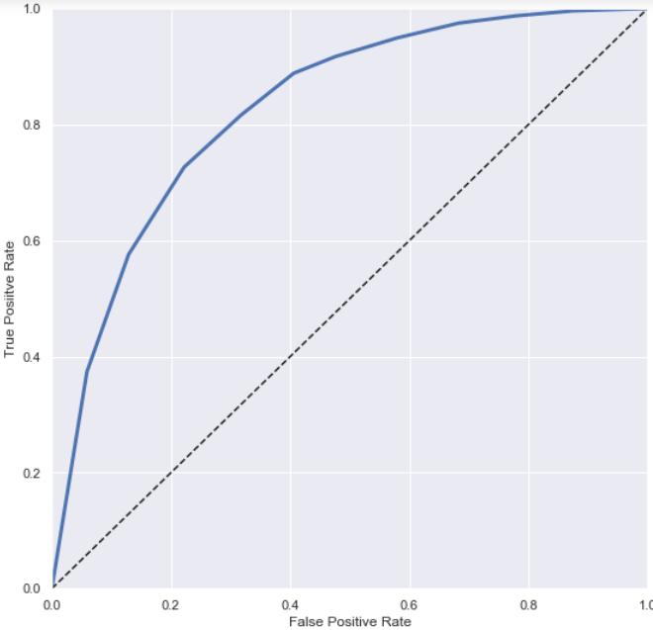
Logistic regression vs KNN
Optimised KNN
 | Testing accuracy | F score
Logistic regression | 0.804 | 0.864
KNN (n =15) | 0.804 | 0.866
Optimised KNN (N= 37) | 0.799 | 0.865
7792 | 702
1722 | 1893

Slide 11
From here…
Apply the classification on the data missing and see if the new data set can improve RMSE of Price model
Tune the features according to its importance
Decompose the time series data to extract trend and possible seasonality,

